Slide 1

Course Code: MATH 211
Course Title: MATH III
Lecture 10 (Laurent’s Series)
Tazin Tamanna
Lecturer in Mathematics
Department of Science and Humanities
M.Sc. in Applied Mathematics (KU)
B.Sc. in Mathematics (KU)

Slide 2
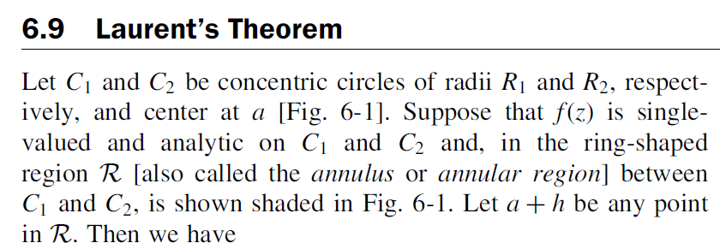
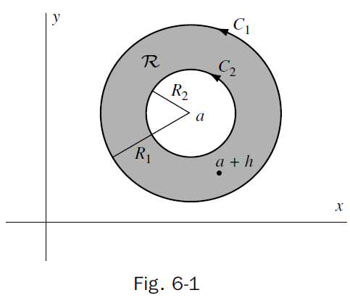
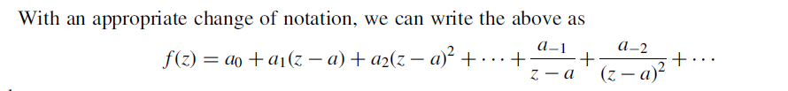




Slide 3
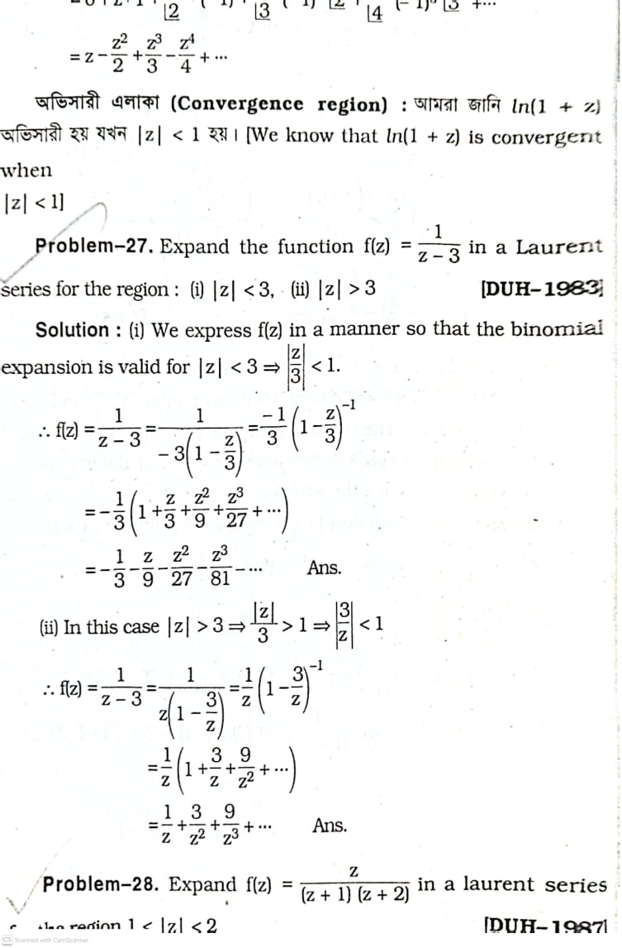
EX-1:

Slide 4
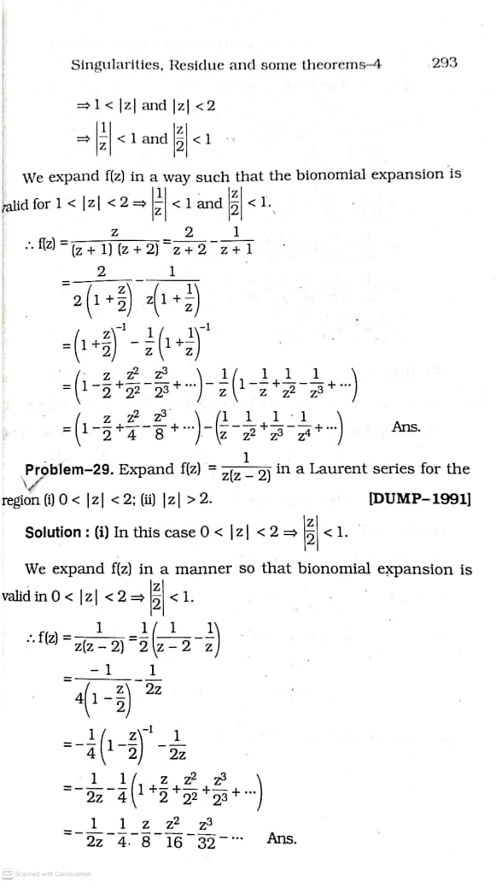
EX-2:

Slide 5
EX-3:

Slide 6
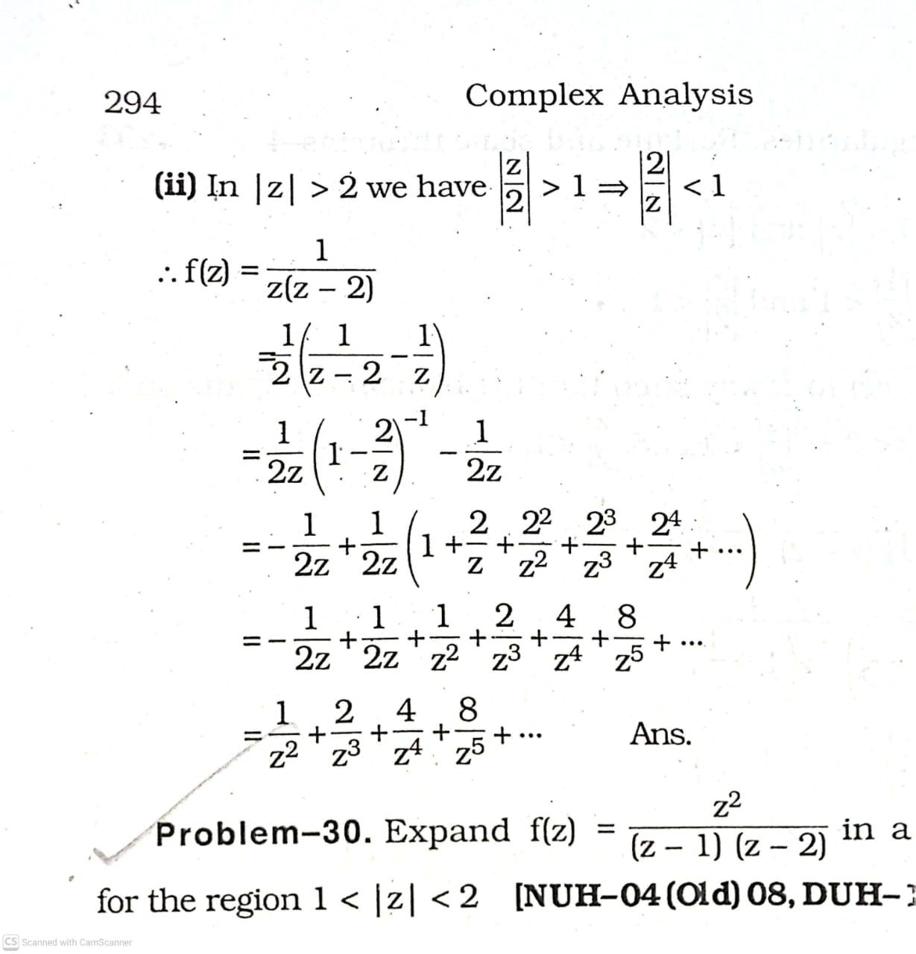

Slide 7
EX-4:

Slide 8
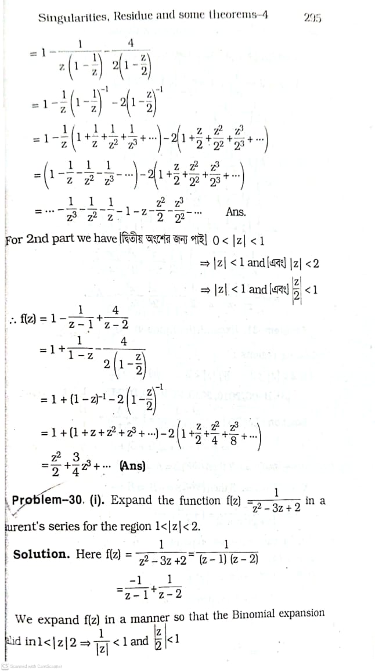

Slide 9
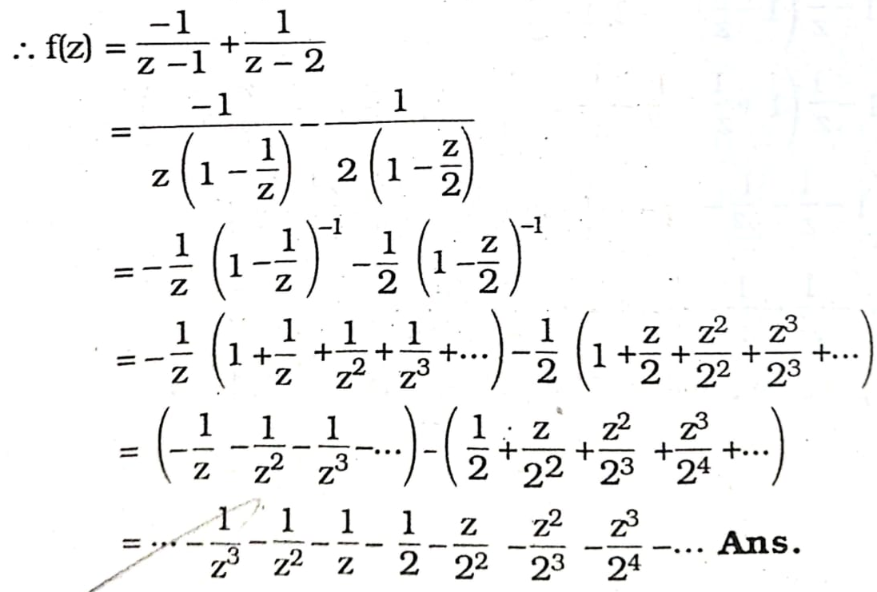
Ex-05:

Slide 10
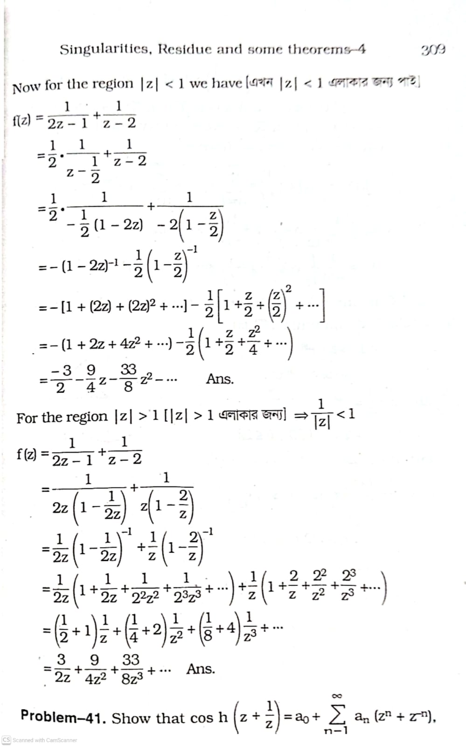
Ex-06:

